Slide 1
IBM University Engagement Project Submission
“Exploring the Power of Agentic AI with IBM Granite and LangFlow”

Slide 2

Project Tile – College Admission Agent
Domain of Project – Education
Student Name | Recent Passport Photo | Email ID | Mobile number [WhatsApp]
Sahil Vishwakarma |  | Sahilvishwakarmaq3451@hmail.com | 7084640486

Slide 3
Problem Statement -
Problem Statement No.4 - College Admission Agent ( RAG Based )
The Challenge - A College Admission Agent, powered by RAG (Retrieval-Augmented Generation),
streamlines the student admission process.
It retrieves and summarizes admission policies, eligibility criteria, and FAQs from institutional databases
and official sources.
Prospective students can ask natural language questions and receive accurate, up-to-date responses
instantly.
The agent helps with course selection, application guidance, fee structure, and important deadlines.
Using trusted, real-time data, it reduces manual inquiries and enhances applicant experience.
This AI-driven assistant boosts transparency, accessibility, and efficiency in college admissions.
Technology - Use of IBM cloud lite services /IBM Granite is mandatory.

Slide 4
Technology Used
Tech Stack (Mandatory)
Use any one of the following approaches:
LangFlow + IBM watsonx.ai + Granite Models
IBM Cloud Agentic Lab with IBM Granite Models
Replicate with LangChain + RAG + IBM Granite Models
I used IBM Cloud Agentic Lab with IBM Granite Models

Slide 5
Proposed Solution -College Admission AI Agent
The proposed solution is an autonomous, AI-powered College Admission AI Agent built on the IBM watsonx Orchestrate framework and powered by IBM Granite foundational models. It delivers personalized, real-time admission counseling and automates informational workflows, removing friction in course selection, eligibility tracking, and fee calculations.
The system implements a Grounded Retrieval-Augmented Generation (RAG) pipeline. Official university brochures are vectorized and stored in the watsonx.data Vector Database. This allows the core IBM Granite-4.0-8B-Instruct model to extract and summarize intricate details (eligibility criteria, fees, rankings) with zero risk of hallucinations.
The Orchestrated Skill Architecture (4 Core Modules):
Using the watsonx Skill Flow Manager, the system dynamically coordinates four specialized cognitive paths:
Academic Knowledge Orchestrator: Instantly retrieves precise course details, curricula, and intake rules across all undergraduate, postgraduate, and doctoral disciplines.
Fee & Scholarship Validation Skill: Generates hyper-personalized financial breakdowns in real time. It calculates exact tuition, hostel, and transport fees while automatically applying merit-based scholarship waivers.
Infrastructure & Campus Advisory Skill: Delivers rich, virtual campus insights, highlighting smart classrooms, labs, and specialized training facilities.
Corporate Placement & Career Engine: Maps student academic streams to active placement trends, industry networks, and prominent recruiters.
Orchestration and Enterprise Interface
The frontend features a modern web portal with an embedded watsonx Web Chat Channel. Behind the scenes, IBM watsonx Orchestrate manages the entire lifecycle—handling seamless context switching, autonomous task routing, and session memory. Concurrently, watsonx.ai ensures scalable model deployment and enterprise-level AI safety guardrails for a reliable user experience.

Slide 6
Orchestrate component Used -
1) Chat Input / Web Chat Channel
Description: The frontend user interface layer (embedded web chat widget) where users input their queries, preferences, or specific admission/dietary details. watsonx Orchestrate exposes this natively through its channel integrations.
2) watsonx Orchestrate Engine
Description: The central cognitive manager that receives frontend inputs. It acts as the orchestrator to analyze user intent and maps it directly to autonomous skill executions or multi-step automated process flows.
3) Core LLM Engine: Granite-4.0-8B-Instruct
Description: The foundational reasoning engine powering the backend via the watsonx platform. This specific model is highly optimized, fast, and efficient for real-time instruction processing and delivering quick, structured responses.
4) Chat Output / Response Handler
Description: The interface responsible for rendering the agent's responses. It displays AI-generated suggestions, tailored data tables, or process timelines neatly back to the end-user inside the chat widget wrapper.

Slide 7
5) watsonx Contextual Memory & Session Storage
Description: The internal data component that stores and retrieves active user states, session history, and variables. This allows the agent to maintain context throughout continuous, multi-turn conversations without losing track of user logs.
6) Skill Catalog / Custom API Integration (Additional Component)
Description: A core architecture component of watsonx Orchestrate used to connect the agent with external datasets, server endpoints, or document logs. It allows the orchestrator to trigger specific digital skills and fetch dynamic, real-time data instead of relying on static responses.

Slide 8
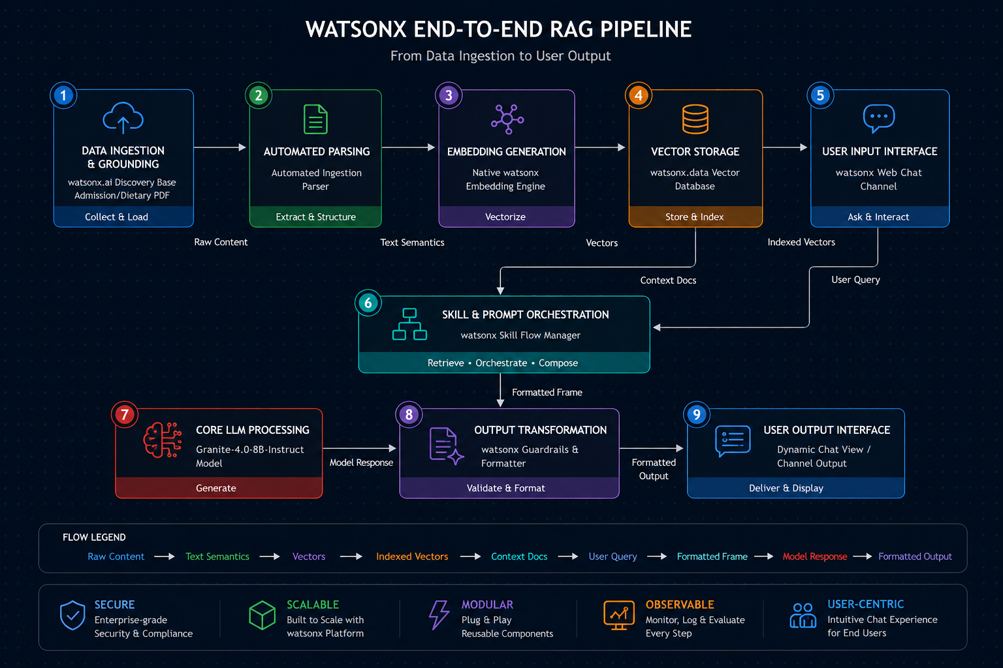
Architecture blueprint

Slide 9
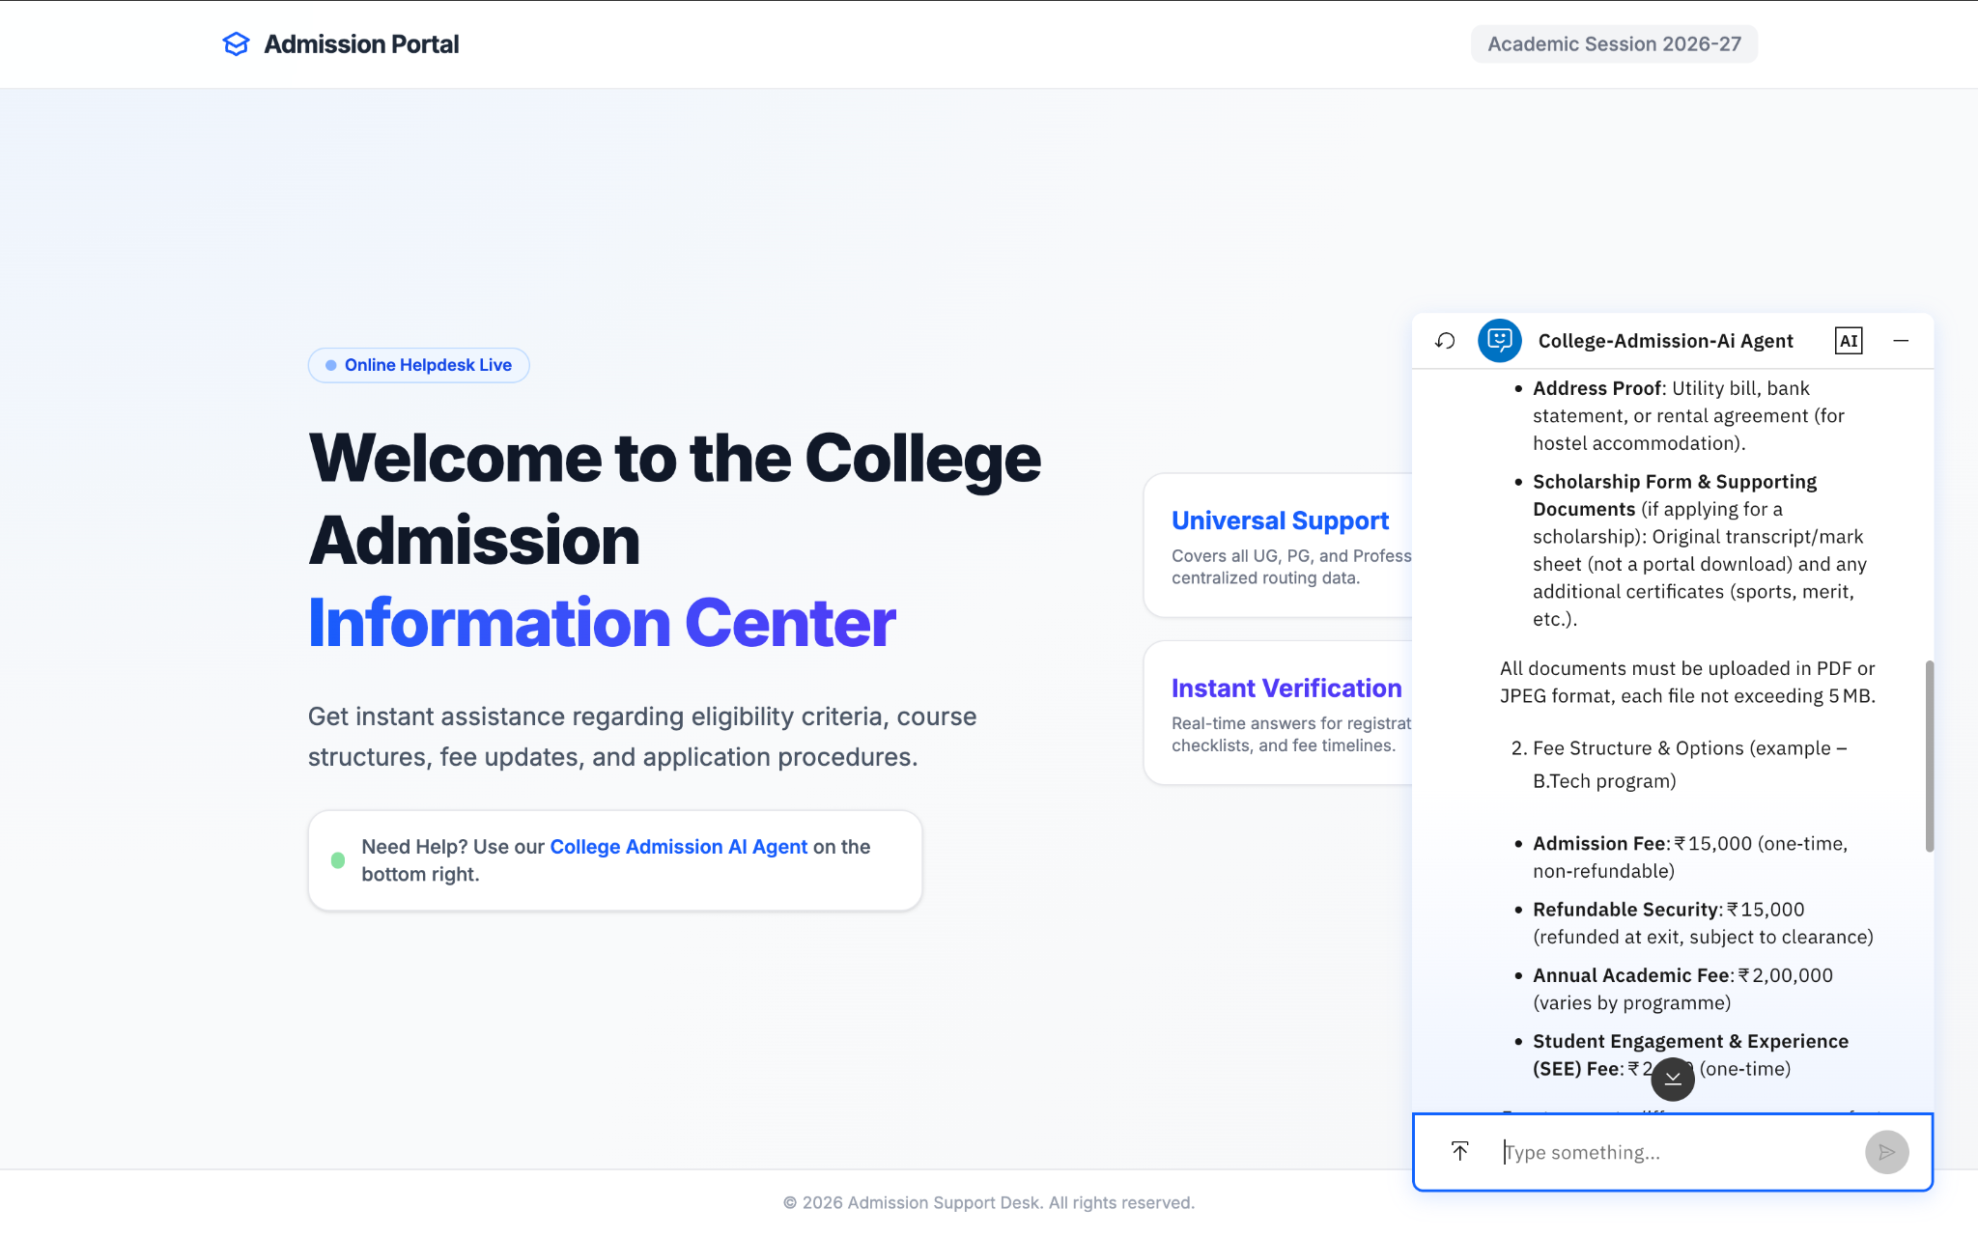
Working Model

Slide 10
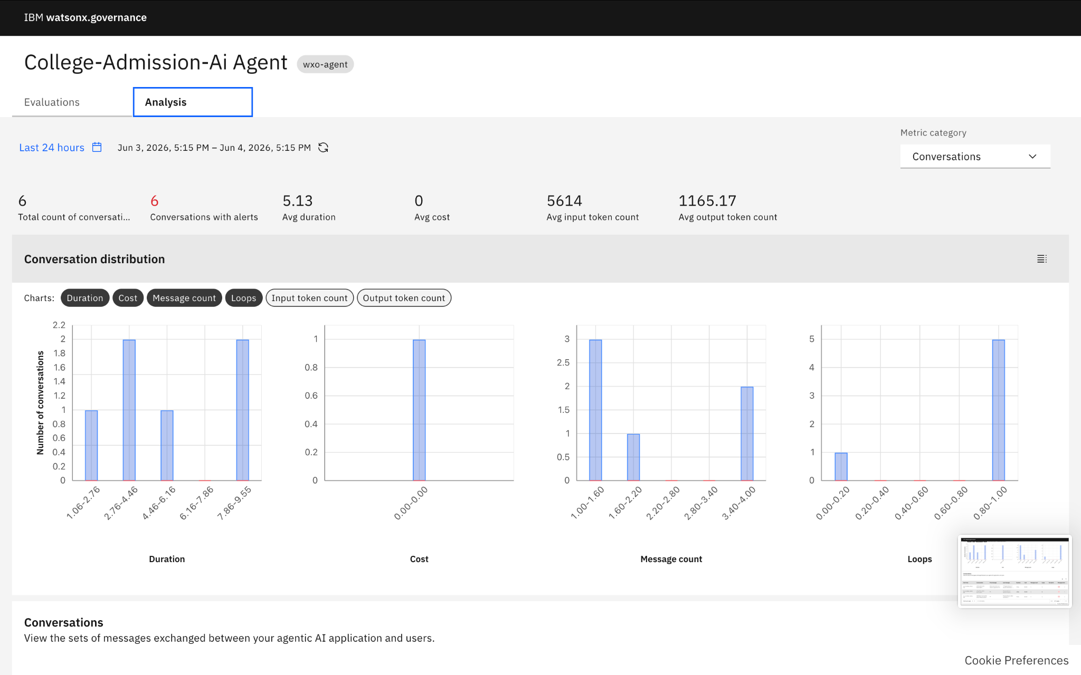
Agent Analysis

Slide 11
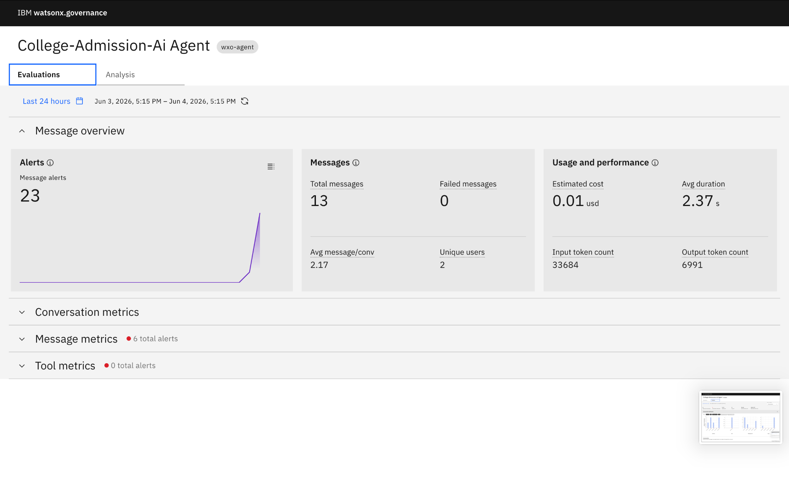
Agent Evaluation record

Slide 12

Role of Agentic AI in the solution
Agentic AI enables the College Admission Agent to function as an intelligent, autonomous system rather than a simple rule-based chatbot. Built on the IBM watsonx Orchestrate framework and powered by the core foundational IBM Granite-4.0-8B-Instruct model, it seamlessly coordinates the entire information extraction, execution, and reasoning workflow to deliver personalized, real-time admission guidance.
The system dynamically orchestrates data workflows using the watsonx Skill Flow Manager. Instead of routing queries through rigid static lines, it relies on a managed Knowledge Grounding Base that ingests the raw university brochure PDF. Through an automated ingestion parser, the platform handles token-efficient semantic processing and structures the data streams dynamically, ensuring high computational accuracy, enterprise-grade safety, and rapid retrieval times.
Agentic AI brings deep context awareness to the system. By cross-referencing user questions entered via the watsonx Web Chat Channel against high-density vector representations securely stored in the integrated watsonx.data Vector Database, the core Granite model easily understands intricate parameters. It can process complex student queries regarding specific course eligibility aggregates, multi-tier annual fee structures, and applicable scholarship percentages.
Furthermore, the agent utilizes integrated watsonx Guardrails and Response Formatters. This architecture component automatically translates advanced cognitive reasoning into clear, scannable UI cards, JSON schemas, or tabular formats tailored for the prospective student.
Overall, Agentic AI transforms the application into a proactive, precise, and goal-driven system. By functioning through the watsonx Orchestrate environment, it acts as an autonomous digital university counselor that seamlessly steers prospective applicants from initial academic inquiry to final enrollment clarity.

Slide 13
Technology Used
1. IBM watsonx Orchestrate Platform
Role: Centralized Automation & AI Orchestration Environment.
Description: Serves as the primary workspace for designing, managing, and orchestrating intelligent digital skill flows. It enables the creation of an autonomous agent that can execute multi-turn conversational paths, handle context switching, and manage channel integrations natively without relying on visual third-party graph builders.
2. IBM Granite Model (granite-4.0-8b-instruct)
Role: Core Cognitive Reasoning Engine.
Description: Acts as the primary brain of the admission agent. This foundational model processes formatted instructions, synthesizes context retrieved from documents, understands complex university regulations, and generates human-like, secure, and accurate text
3. IBM Cloud Infrastructure
Role: Enterprise-Grade Hosting & Deployment Layer.
Description: Provides the underlying cloud infrastructure to host, secure, and scale the admission system. It guarantees high availability, low-latency API handling, robust user data encryption, and a stable runtime environment required for live public deployment.
4. Grounded RAG (Retrieval-Augmented Generation)
Role: Architectural Data Extraction Pattern.
Description: The structural pipeline used to fetch real-time facts directly from the official university brochure before generating responses. By dynamically inserting specific policy documents into the model's context window, it eliminates hallucinations and ensures that critical figures like admission deadlines, fees, and eligibility grids are 100% factual.

Slide 14
5. IBM watsonx.ai
Role: Operational AI Layer & Embedding Lifecycle Management.
Description: Powers the foundational AI lifecycle by managing scalable model deployment, secure endpoints, and enterprise-level AI governance. It also houses the high-fidelity embedding models that translate raw brochure texts into dense numerical vectors for precise semantic mapping.
6. watsonx.data Vector Database
Role: High-Performance Semantic Vector Store.
Description: Acts as the dedicated knowledge repository for the system. It safely stores the processed text vectors of the university brochure and executes low-latency similarity indexing to retrieve the most contextually relevant sections whenever a prospective student asks a question

Slide 15
Novelty and Uniqueness
The proposed College Admission AI Agent
The system combines Agentic AI, Grounded RAG, and deep personalization into a single enterprise-ready solution.
Autonomous Orchestration: Replaces rigid chatbots with the native watsonx Skill Flow Manager to dynamically handle context switching and multi-step conversational paths.
RAG-Based Factual Accuracy: Integrates a direct retrieval loop with watsonx.ai and watsonx.data Vector Database to eliminate AI hallucinations, ensuring 100% factual responses grounded in the official university brochure.
Hyper-Personalized Fee & Scholarship Matrix: Dynamically evaluates a student's profile (e.g., test scores, aggregates) against university policies to calculate exact fee waivers and scholarship tiers in real time.
Automated Ingestion Parsing: Utilizes IBM's advanced ingestion pipeline to perfectly preserve complex data structures like fee brackets, intake capacities, and eligibility criteria during vector indexing.
Structured UI Output Generation: Uses watsonx Guardrails and Formatters to transform complex reasoning into clean, scannable UI cards and structured tables instead of walls of plain text.
Enterprise Infrastructure: Powered by the IBM Granite-4.0-8B-Instruct model on IBM Cloud, guaranteeing low-latency execution, robust data compliance, and enterprise-grade safety governance.

Slide 16
Git Hub Link
Please create public github repository (Enable Add README button while creating repository) with format –
Please test and Paste the working Github URL –https://github.com/sahylvishwakarma/College-admission-Ai-Agent
Make sure you have Uploaded following three files into your github repository
·

Slide 17
Future Scope
1. Integration with Centralized Academic Portals & Document Verification
The system can be integrated with national academic depositories (like DigiLocker) and school board databases to pull real-time student transcripts, board marks, and competitive exam scores (CUET, JEE, CLAT). This will enable the College Admission Agent to automatically verify a student's eligibility criteria and instantly process academic fee waivers or merit-based scholarships without manual paperwork.
2. AI-Powered Voice Assistant & Hinglish/Multilingual Support
Enhancing the system with a voice-enabled conversational AI agent that supports multiple regional languages—with a strong focus on Hinglish and native dialects—will drastically improve accessibility. Prospective students and parents from diverse linguistic backgrounds can naturally converse with the system to ask complex questions about courses, hostel fees, and campus amenities, making the enrollment journey highly inclusive and user-friendly.
·
·
·

Slide 18


